Slide 1
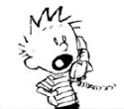



Functional MRI preprocessing
Sunnybrook Neuroimaging summer school fMRI Module Tutorial 1
Guocheng Jiang
If you want to try different preprocessing pipelines on your laptop but have not installed the software libraries:
Windows Users need to download a virtual machine:
1. Install Virtualbox (www.virtualbox.org/wiki/Downloads)
2. Download the VM OVA file (http://bit.ly/4mFVDIo)
3. Open Virtualbox, and select “File—>Import Appliance”
4. Select the downloaded OVA file and press “Next—>Finish”
Mac and Linux users can directly download the FSL, no virtual machine is needed:
1. FSL: https://fsl.fmrib.ox.ac.uk/fsl/docs/#/install/index
2. AFNI: https://afni.nimh.nih.gov/pub/dist/doc/htmldoc/background_install/main_toc.html
Dataset links:
Dataset 1: http://bit.ly/3VfLGp6
Dataset 2: http://bit.ly/4fVBdsG

Slide 2
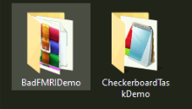
We will use the following datasets for demonstration
BadFMRIDemo: From Newbi4fMRI Group (Western University).
https://www.newbi4fmri.com
Face-Hand visual stimuli
Participants were instructed to move during the scan to simulate motion artifacts.
Example of bad fMRI acquisition
CheckerBoardTaskDemo: From Boston University
https://openneuro.org/datasets/ds004478
Flickering radial checkerboard visual stimuli
Example of good fMRI acquisition
(Optional) Contains a occipital EEG channel!

Slide 3

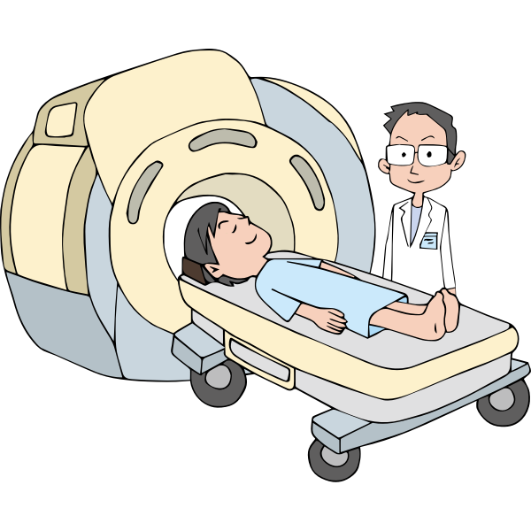


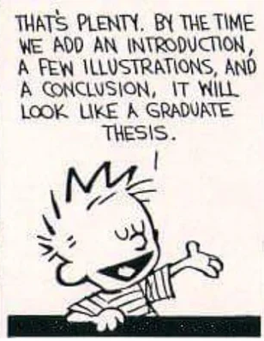
Schedule of the tutorial:
Topic 1: Guided tour of a typical fMRI data folder in BIDS format.
Topic 2: Learning the basic toolkit we have for fMRI preprocessing
** Actually more works are needed in a real thesis
Topic 3: Building up a simple preprocessing pipeline using FEAT GUI

Slide 4
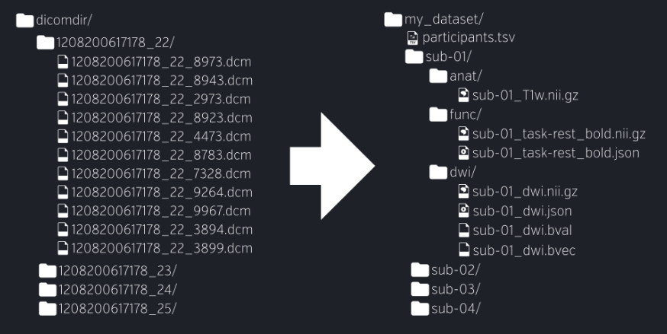
Exercise 1: The Brain Imaging Data Structure (BIDS) format
Demographics
Subject ID
T1w data
fMRI data
Other MRI data
To-dos: Within the Checkerboard Task Demonstration Dataset
What is the age and sex of participant sub-02?
What was the manufacturer of the MRI scanner they used in the study? What was the field strength?
What is the TR of the fMRI data?

Slide 5
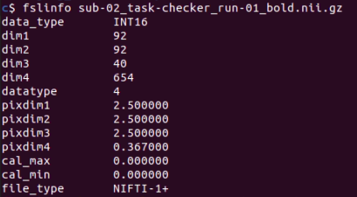
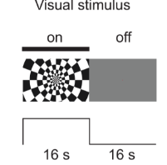
Exercise 2.1 : Inspect the fMRI data: sub-02 task-checker run-01 BOLD
To-dos: Use fslinfo command to inspect the following acquisition parameters:
Field of view (dim1-3)
Spatial resolution (pixdim1-3)
Numbers of data points (dim4)
TR (pixdim4)
Command: fslinfo <xxx.nii.gz>
* Replace the “xxx” with your own file name.
Question: In the experimental design, we know that the visual stimuli will be 16s ON and 16s OFF. Roughly how many TRs you will expect to see an increased BOLD effect? What factors can alter this haemodynamic response in the actual experiment?

Slide 6
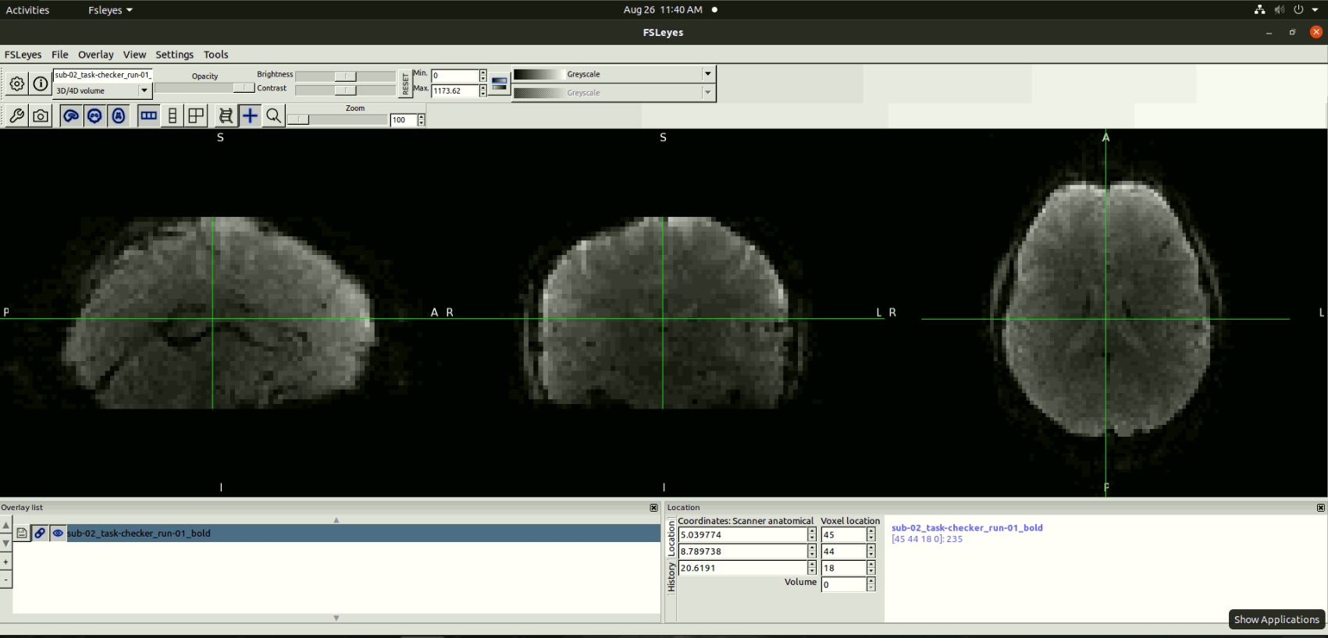
Exercise 2: Load the fMRI data: sub-02 task-checker run-01 BOLD
To-dos: Open the FSLeyes GUI
Open up a terminal
Type and run the following code: fsleyes

Slide 7
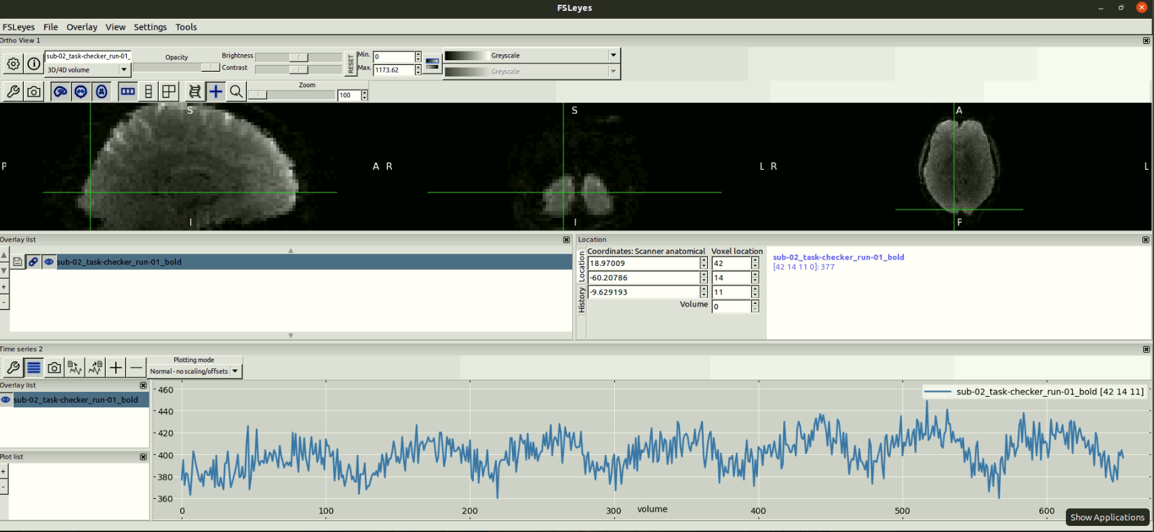
Exercise 3: Create a time series plot at your favorite brain ROI
To-dos: Locate the primary visual cortex and try identify this classic haemodynamic function pattern related to ON/OFF of the visual stimuli.

Slide 8
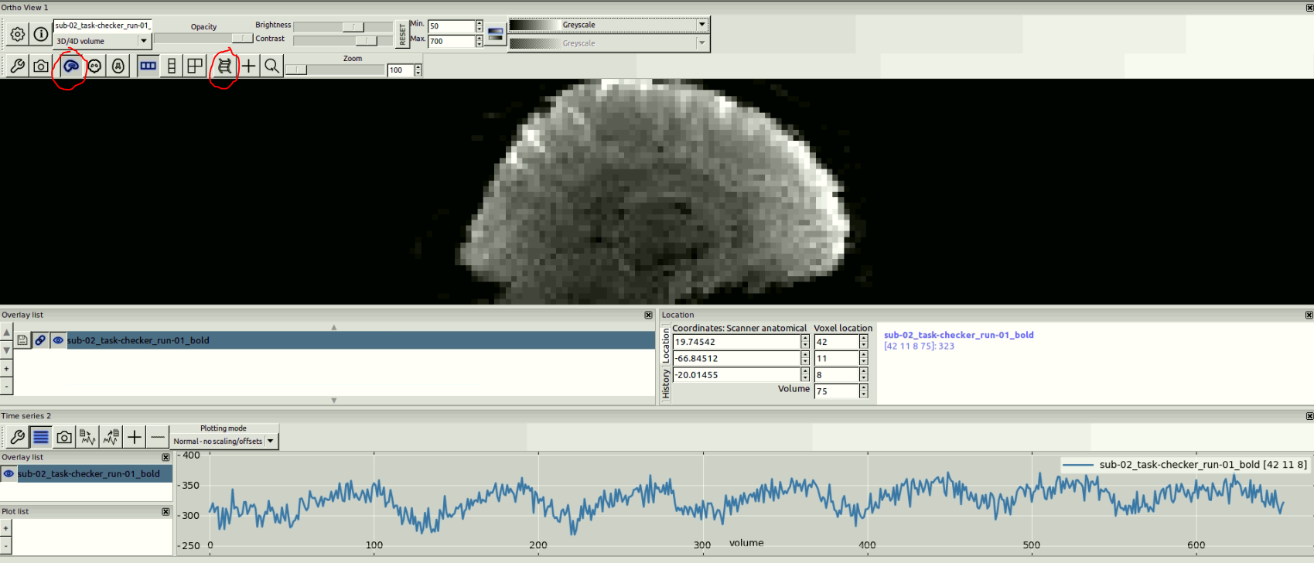
Exercise 4: Play the fMRI time series as a movie
To-dos: When you play the movie, please observe:
How do you describe the “image quality” of the movie?
Did you see a lot of head motion?

Slide 9
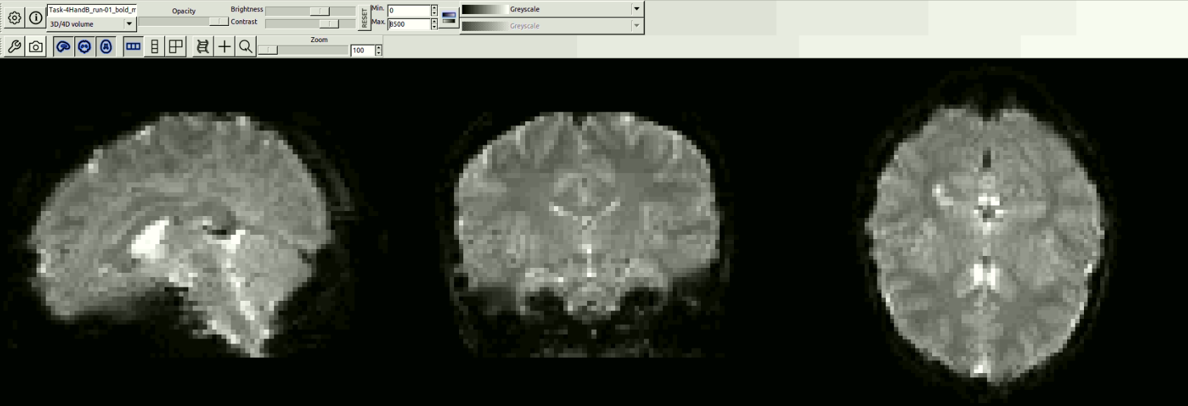
Exercise 5: Load the BadFMRI dataset: Task-4HandB_run-01_bold_movement_artifact_demo
To-dos: Load the dataset to the fsleyes and try to diagnose:
How do you describe the “image quality” of the movie?
Did you see a lot of head motion?
What will be your “treatment plan” for this image?

Slide 10
Schedule of the tutorial:
DONE!
Topic 1: Guided tour of a typical fMRI data folder in BIDS format.
Topic 2: Learning the basic toolkit we have for fMRI preprocessing
** Actually more works are needed in a real thesis
Topic 3: Building up a simple preprocessing pipeline using FEAT GUI

Slide 11
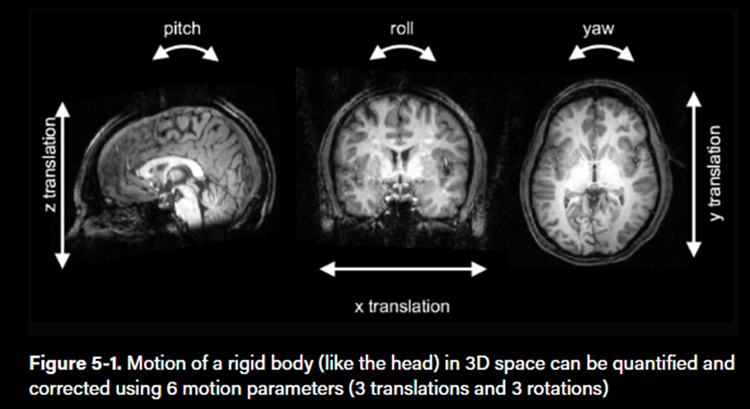
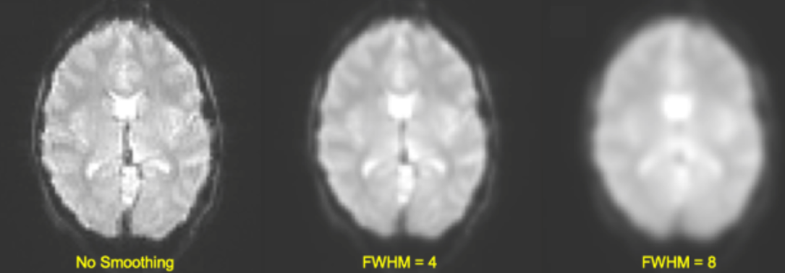
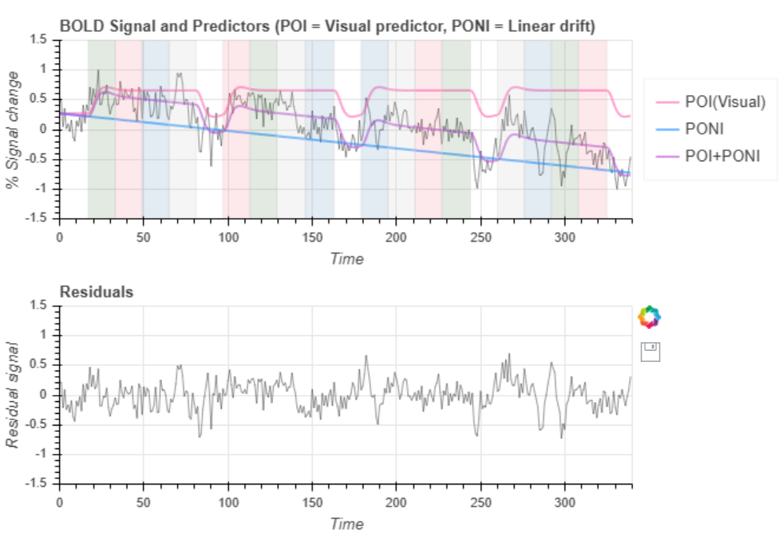
Topic 2: Various tools for functional MRI preprocessing
Head motions: Motion corrections
Noisy images: Spatial smoothing
Physical/Physiological noises: Temporal filtering

Slide 12
Exercise 6: Motion correction
Motion correction algorithms attempt to correct the voxel shift over time and correct the signal drift and spikes.
These algorithms realign each volume with a reference volume using 3 translation and 3 rotation parameters.
We can also add motion as a predictor of no-interest to the GLM. This method will work if the motion predictors are not highly correlated with our activation pattern, but if it do, then you are removing signals. (Optional, will not discussed here)

Slide 13
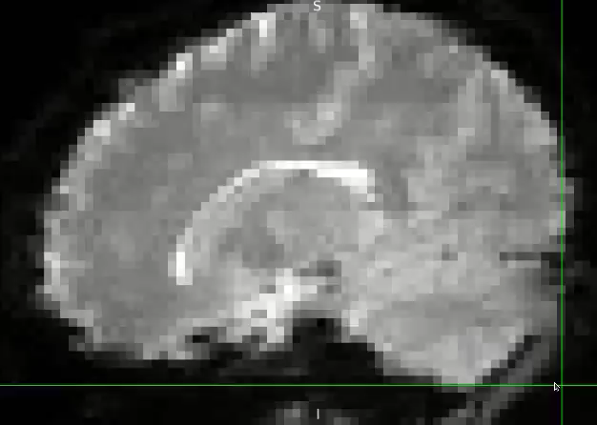
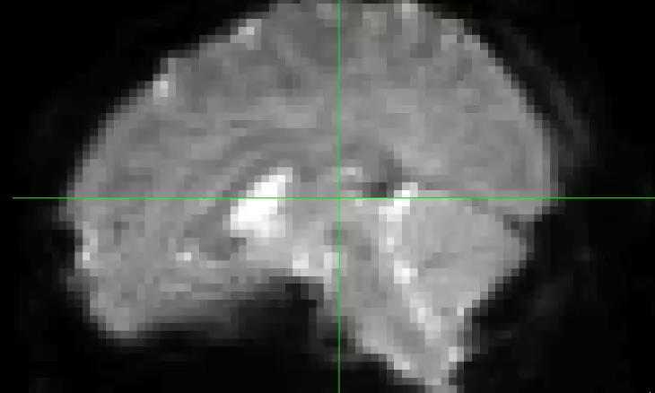
Exercise 6: Motion correction using MCFLIRT
FSL command: mcflirt –in <input.nii.gz> -out <output.nii.gz> -plots […]
Before motion correction
After motion correction

Slide 14
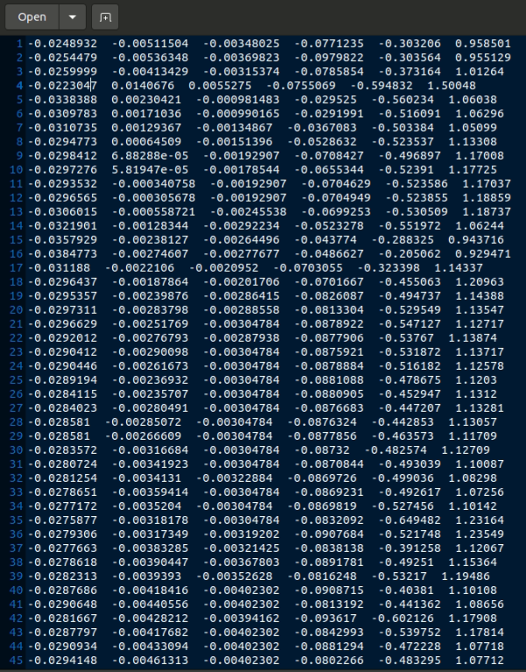
Exercise 6: The motion estimates can be used for future noise regression
6 parameter motion estimates:
Rotation X
Rotation Y
Rotation Z
Translation X
Translation Y
Translation Z
Tip:
We can add motion as a predictor of no-interest to the GLM. This method will work if the motion predictors are not highly correlated with our activation pattern, but if it do, then you are removing signals! (Optional)
BOLD(t)=β0​ + β1​⋅Task1(t) + β2​⋅Task2(t) + … +γ1​⋅Motion1​(t)+⋯+γ6​⋅Motion6​(t)+ϵ(t)

Slide 15
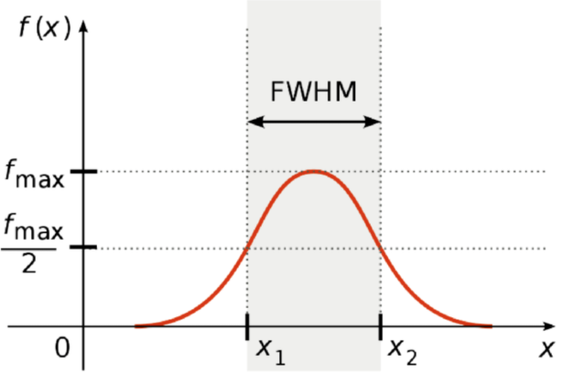
Exercise 7: Apply spatial smoothing using FSLMath toolbox
During spatial smoothing, each voxel’s intensity is computed as a weighted average of its own intensity and the intensities of its neighbors with a set radius.
The weights are determined by a Gaussian function and its size is characterized by full width at half maximum (FWHM) of the smoothing kernel.

Slide 16
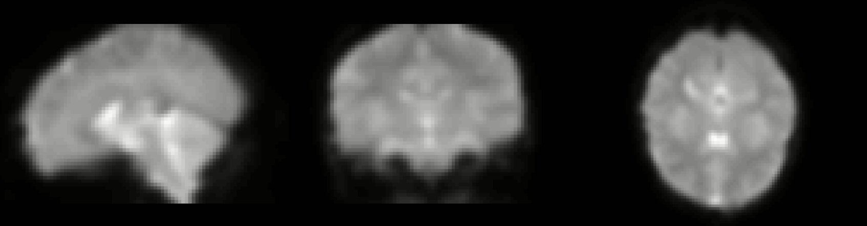
Exercise 7.1: Use FSLMaths toolbox to apply different Gaussian Kernel
FSL command: fslmaths <input.nii.gz> -s <sigma_mm> <output.nii.gz>
2.5mm kernel
To-dos: Try apply different Gaussian Kernels (2.5mm, 5mm, 10mm, 20mm) to the data and observe:
Do you see there are less noise in the image?
Do you over-clean the data?

Slide 17
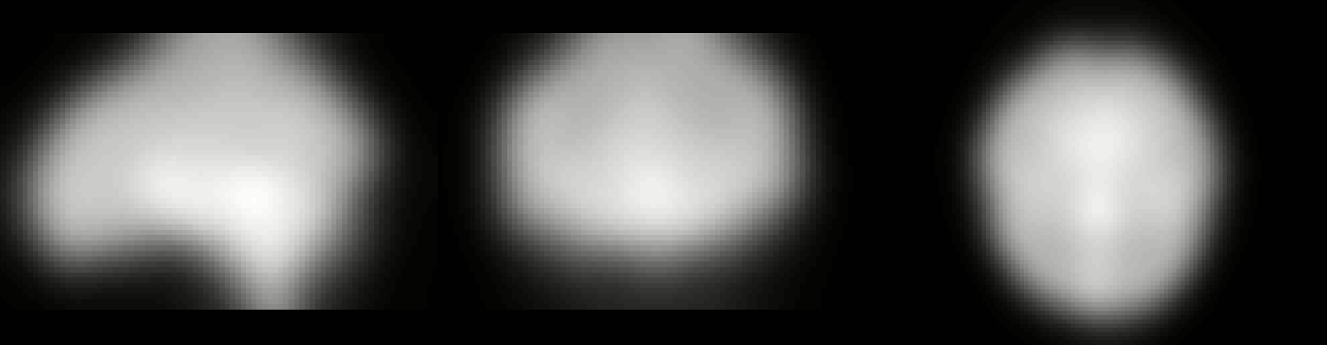
Exercise 7.1: Use FSLMaths toolbox to apply different Gaussian Kernel
FSL command: fslmaths <input.nii.gz> -s <sigma_mm> <output.nii.gz>
10mm kernel
To-dos: Try apply different Gaussian Kernels (2.5mm, 5mm, 10mm, 20mm) to the data and observe:
Do you see there are less noise in the image?
Do you over-clean the data?

Slide 18
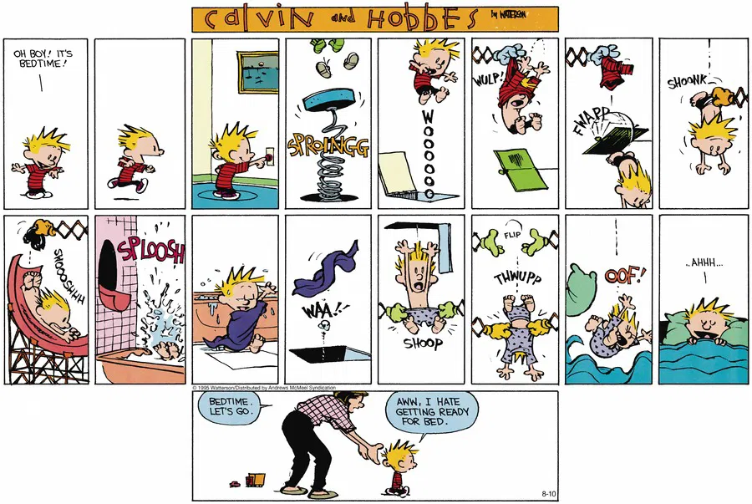
Let’s take a break …
Its break time!!
Let’s go back to work
AWW, ASL
https://www.gocomics.com/calvinandhobbes/2025/08/10

Slide 19
Exercise 8: Temporal filtering
fMRI data tends to have high noise in particular frequency bands:
The very low frequencies can be related to scanner drift and participant relaxation; this leads to a linear trend issue.
The 0.3Hz band is close to the frequency of breathing. (12-20 breaths/min)
The 1 Hz band is close to the frequency of heart rate. ( ~ 60 BPM)
< 0.01Hz
0.10 Hz
0.30 Hz
> 0.50Hz
(…)
Linear trend
Scanner drift
Task Activation
Repeated motion
(e.g. Head/body rotation)
Breathing
Cardiac

Slide 20
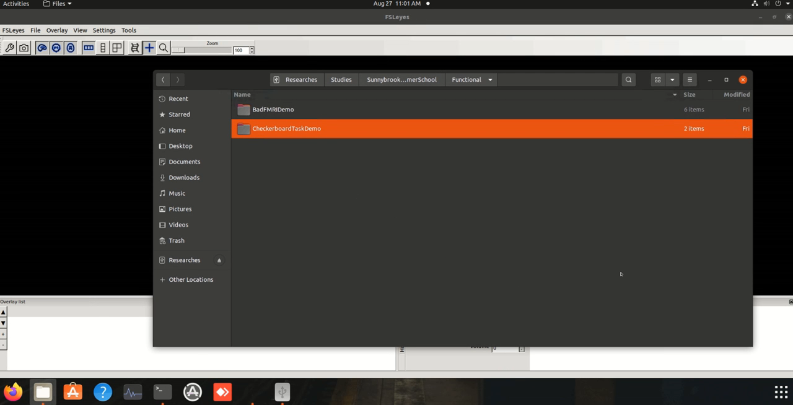
Exercise 8.1: Examine the power spectrum of the fMRI dataset use fsleyes
Hint: Open up the FSLeyes GUI, load the fMRI data, and use “View” > “Power Spectra” to create a time series plot

Slide 21
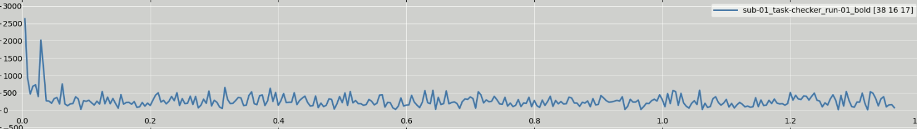
Exercise 8.1: Explore the possible signal drift using time series plots of the FSLeyes GUI
Linear trend
Scanner drift
Task Activation
Breathing
Harmonic of breathing
Cardiac
Question: Where should we put our band-pass filtering to in this case?
Default from some software: 0.01-0.1Hz (Okay for most task- and resting-state fMRI)
Be extra careful if you have a very slow/fast task activation stimuli!

Slide 22
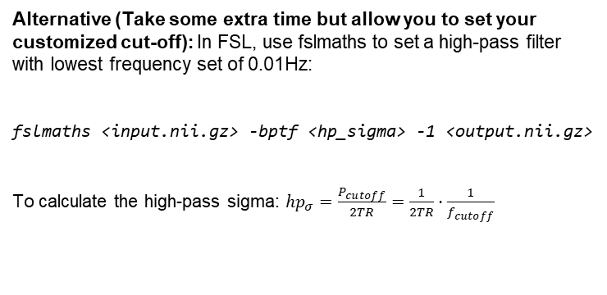
Exercise 8.1: Detrend the data use AFNI
AFNI command: 3dTcat -rlt+ -prefix <output>.nii.gz <input>.nii.gz
Alternative (Take some extra time but allow you to set your customized cut-off): In FSL, use fslmaths to set a high-pass filter with lowest frequency set of 0.01Hz:
fslmaths <input.nii.gz> -bptf <hp_sigma> -1 <output.nii.gz>
To calculate the high-pass sigma: $hp_{σ}=\frac{P_{cutoff}}{2TR}=\frac{1}{2TR}⋅\frac{1}{f_{cutoff}}$
Linear trend modeling simulator:
http://129.100.119.110:22028/LinearDriftFilter

Slide 23
Exercise 8.3: Estimation the cut-off values of the bandpass filter
To-dos: When applying the bandpass filtering, we don’t want to remove the task-related activation, thus I want to estimate what will be the frequency of the task-related signal activation in the dataset.
(Visual stimuli: 16s ON, 16s OFF; Number of time points: 654 time points; TR = 0.367s)

Slide 24
Exercise 8.3: Estimation the frequency of task-related BOLD activation
To-dos: When applying the bandpass filtering, we don’t want to remove the task-related activation, thus I want to estimate what will be the frequency of the task-related BOLD activation in the dataset.
(Visual stimuli: 16s ON, 16s OFF; Number of time points: 654 time points; TR = 0.367s)
Solution:
Total scan time: 654 x 0.367 = 240s
Since each pattern is 16s on and 16s off:
We would expect to see 240/(16x2)=7.5 cycles
The frequency would be: 7.5 / 240 = 0.031 Hz
Thus: When conducting bandpass filtering, please don’t kill the signal around this 0.031Hz range.

Slide 25
Schedule of the tutorial:
DONE!
Topic 1: Guided tour of a typical fMRI data folder in BIDS format.
DONE!
Topic 2: Learning the basic toolkit we have for fMRI preprocessing
** Actually more works are needed in a real thesis
Topic 3: Building up a simple preprocessing pipeline using FEAT GUI

Slide 26
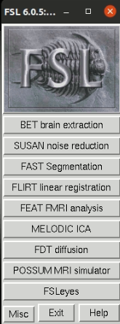
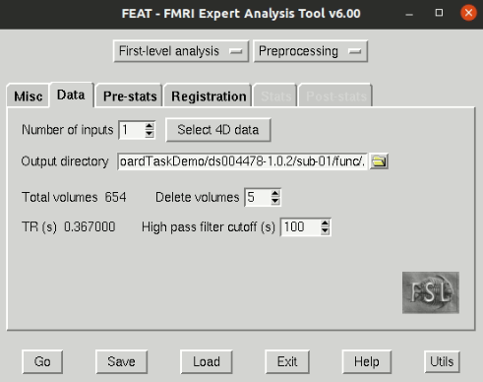
Exercise 9: The FSL FEAT GUI
Open the FSL menu use the following command: fsl

Slide 27
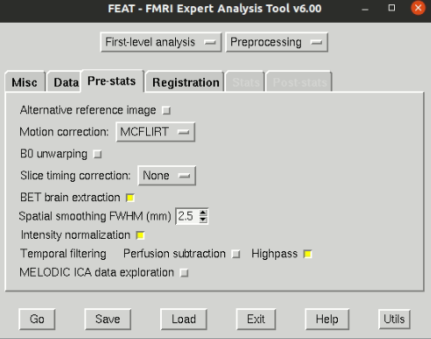
Exercise 9: The FSL FEAT GUI

Slide 28
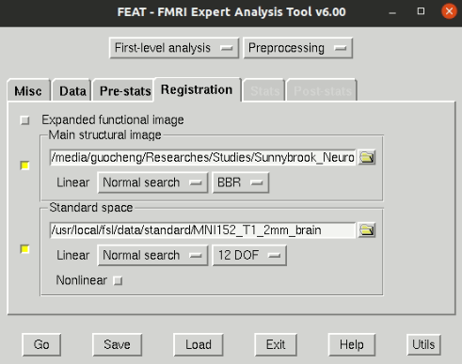
Exercise 9: The FSL FEAT GUI

Slide 29
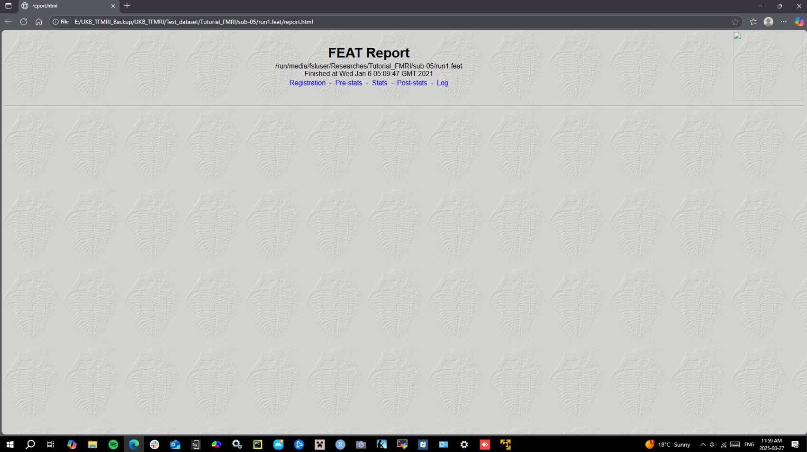
Exercise 9: Read the FEAT report
Find it under your fMRI folder: func/fMRI_name.feat/report.html

Slide 30
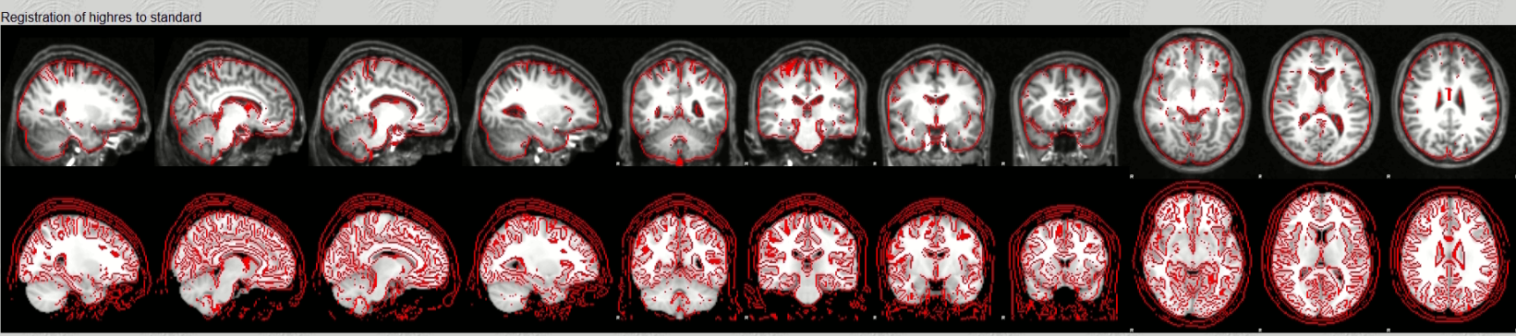
Exercise 9: Read the FEAT report – Registration to standard space

Slide 31
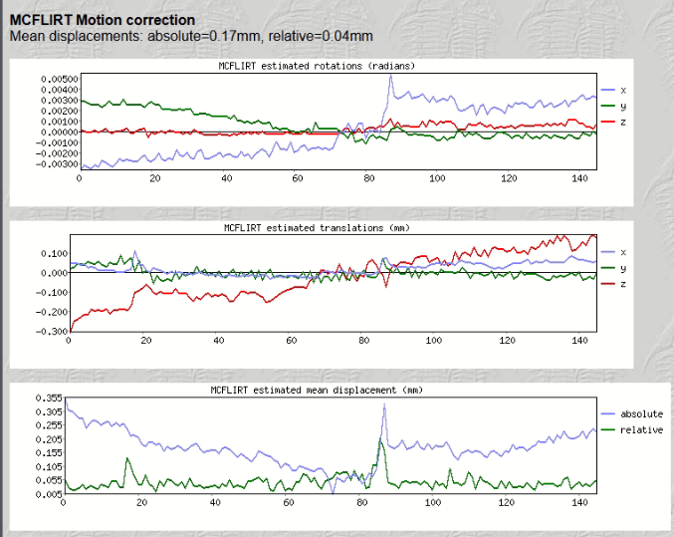
Exercise 9: Read the FEAT report – Prestats motion correction report

Slide 32
Schedule of the tutorial:
DONE!
Topic 1: Guided tour of a typical fMRI data folder in BIDS format.
DONE!
Topic 2: Learning the basic toolkit we have for fMRI preprocessing
** Actually more works are needed in a real thesis
DONE!
Topic 3: Building up a simple preprocessing pipeline using FEAT GUI

